Slide 1






Green University of Bangladesh
Primary School Management System (PSMS)
📖
Presented By: | Supervisor:
Md Mahmudul Hasan Id: 201015083 MD Mamun Ur Roshid Id: 201015066 Ananto Chandra Dey Id: 201015137 | Name: Ms. Babe Sultana Lecturer Department of CSE Green University Of Bangladesh
06/17/2023

Slide 2

Outline
2
Introduction
Objectives
Motivation
Background Study
Tools & Techniques
Work Flow Diagram
Use Case Diagram
Data Flow Diagram
Features

Slide 3
Outline
3
Gantt Chart
Budget
Implementation
Future Work
Conclusion
References

Slide 4
Introduction
4
The Primary School Management System is a comprehensive software project aimed at streamlining and enhancing the administrative and academic processes of a primary school.
This system offers so many features for all the primary schools to make them digital and modern.

Slide 5
Objectives
5
The purpose of school management system is to automate the existing
manual system by the help of computerized equipment and full-fledged
computer software.
So that their valuable information can be stored for a longer period with
easy access.

Slide 6
Motivation
6
At present, primary school management systems are fairly analogue systems.
Due to running on an analogue system, it is seen that there are many duplicate documents. Every document should be kept in a ledger so that resources are no longer available if lost or destroyed.
So, if a software system can be developed through which these documents can be stored on an online server, duplicate data will not be generated, and data redundancy will be reduced.
For this reason, we want to make software through which the functionality required according to the primary school category will be here

Slide 7
7
Background Study
Bidyaan
Bidyaan is an advanced Education Management System in Bangladesh. It simplifies
the interaction among Administrator, HRM, Exam control, Teacher, Students,
Parents,..
This website does not have hostel services and transportation services
Students cannot apply through this website
https://www.bidyaan.com/

Slide 8
Background Study (Cont.)
8
Digital Pathshala
The software provides the facility to carry out students, academic, and accounting activities and makes them fast, easy, efficient, and accurate, student subscription, examination, certification, reports generation, result generation, fee counter, library, payroll system and many more.
This website does not have a map, event calendar and transportation service schedule.
http://extreme.com.bd/Software/school-student-software-chittagong

Slide 9
9
Background Study (Cont.)
My Class Campus
My Class Campus is designed to make school management digital and more advanced. The platform allows parents to view the profiles of their children, anytime, from anywhere.
This platform not allows to generate notice board and transportation service
schedule.
https://myclasscampus.com/home

Slide 10
10
Tools & Techniques
Frontend
React js
Next js-
Tailwind CSS
Backend
Node js
GraphQL
Database
PostgresQL
PrismaORM

Slide 11
Work Flow Diagram
Start
11
Student Registration form
Registration Successful
Login
No
If Login is Successful
Student Search for Record
Yes
Student Records
Yes
Performed Successful
Student Select for Report
Student File Upload
No
Yes
Figure: Work Flow Diagram
End

Slide 12
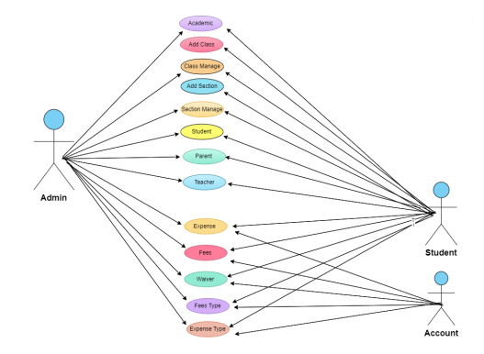
Use Case Diagram
12
Fig: Use Case Diagram

Slide 13
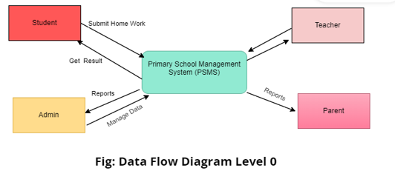
Data Flow Diagram Level 0
13

Slide 14
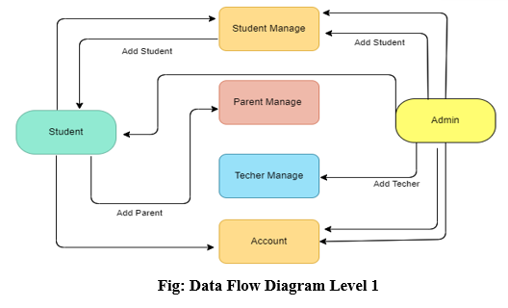
14
Data Flow Diagram Level 1

Slide 15
15
Features
In the proposed system we have several feature. These are:
Search
Manage Students, Teachers, Staff, Parents and Users
Manage Academic Year, Sections, Classes, Class Rooms,
Subjects, Incomes, Expenses, HR
Reports – Students, Teachers, Parents, Staff, Users,
Products, Incomes & Expenses, Students & Staff Attendance,
Visitors Log, Student Records, Class Lists, Events
User Access Role

Slide 16
16
Gantt Chart
Months | 1 | 2 | 3 | 4 | 5 | 6 | 7 | 8
Project Activities
Planning
Design
Coding
Testing
Delivery

Slide 17
Budget
17
No. | Requirements | Unit Cost | Estimated cost (Tk.)
1. | Jr. Web Developer (3 persons) (4 Months) | 5,000/month | 60,000
2. | Sr. Web Developer (1 Month) | 20,000 | 20,000
3. | Domain Cost | - | 5,000
4. | Deployment Cost | -- | 20,000
5. | Miscellaneous | -- | 9,000
 | Total |  | 114,000

Slide 18
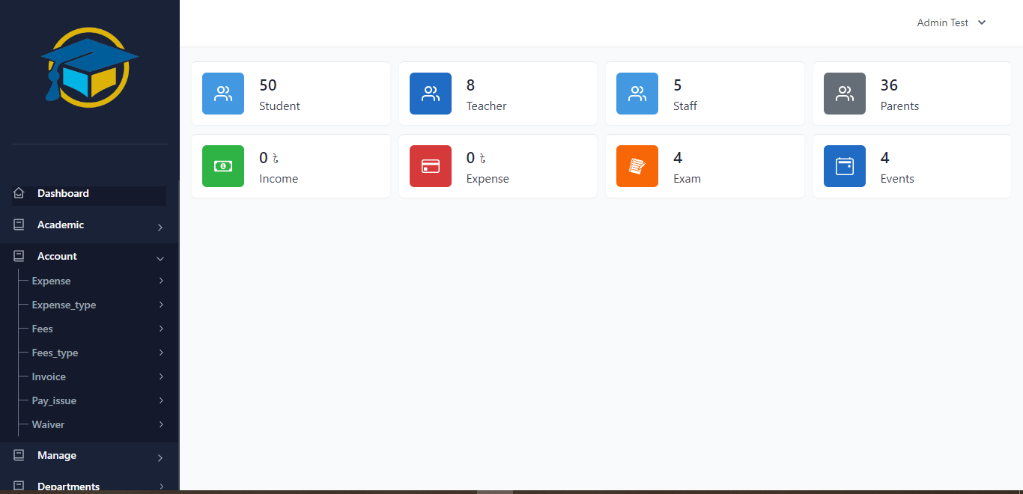
Implementation
18

Slide 19
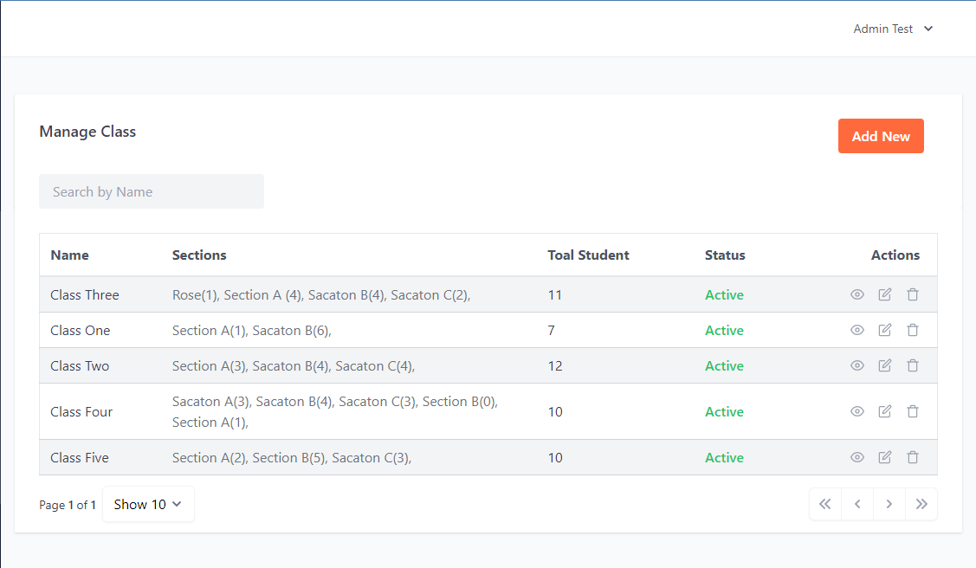
Implementation (Cont.)
19

Slide 20
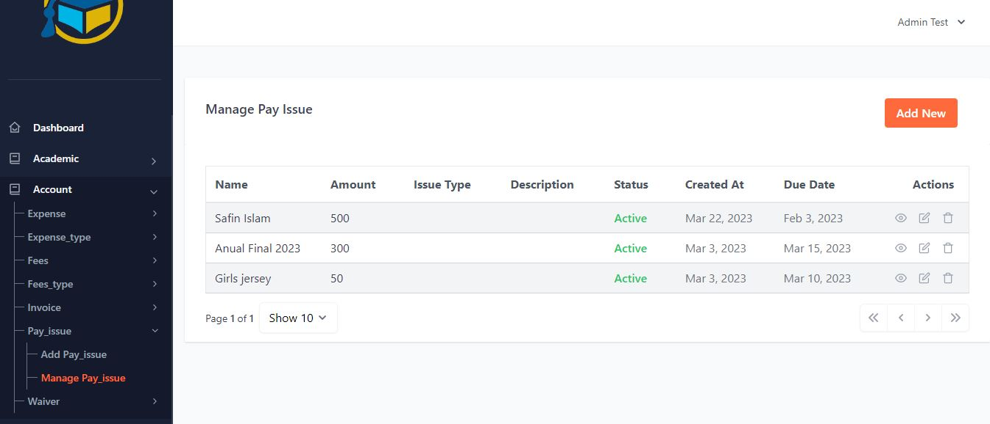
Implementation (Cont.)
20

Slide 21
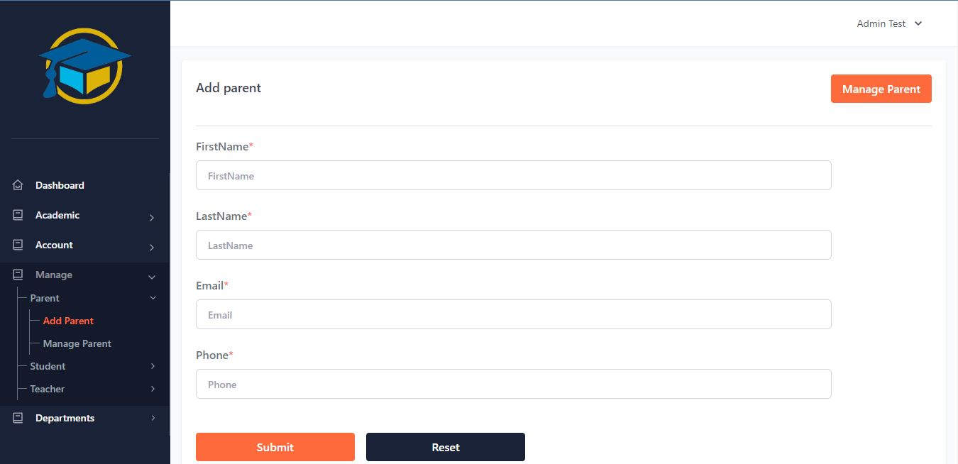
Implementation (Cont.)
21

Slide 22
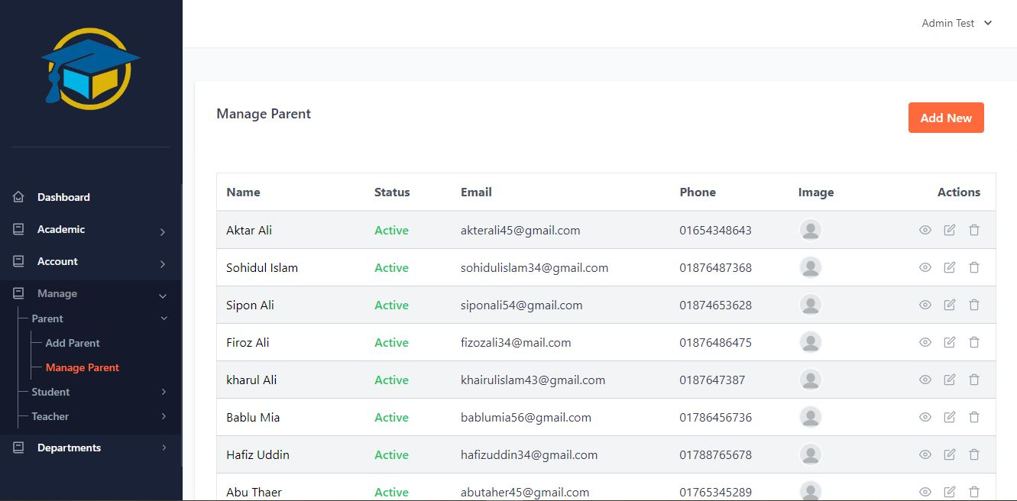
Implementation (Cont.)
22

Slide 23
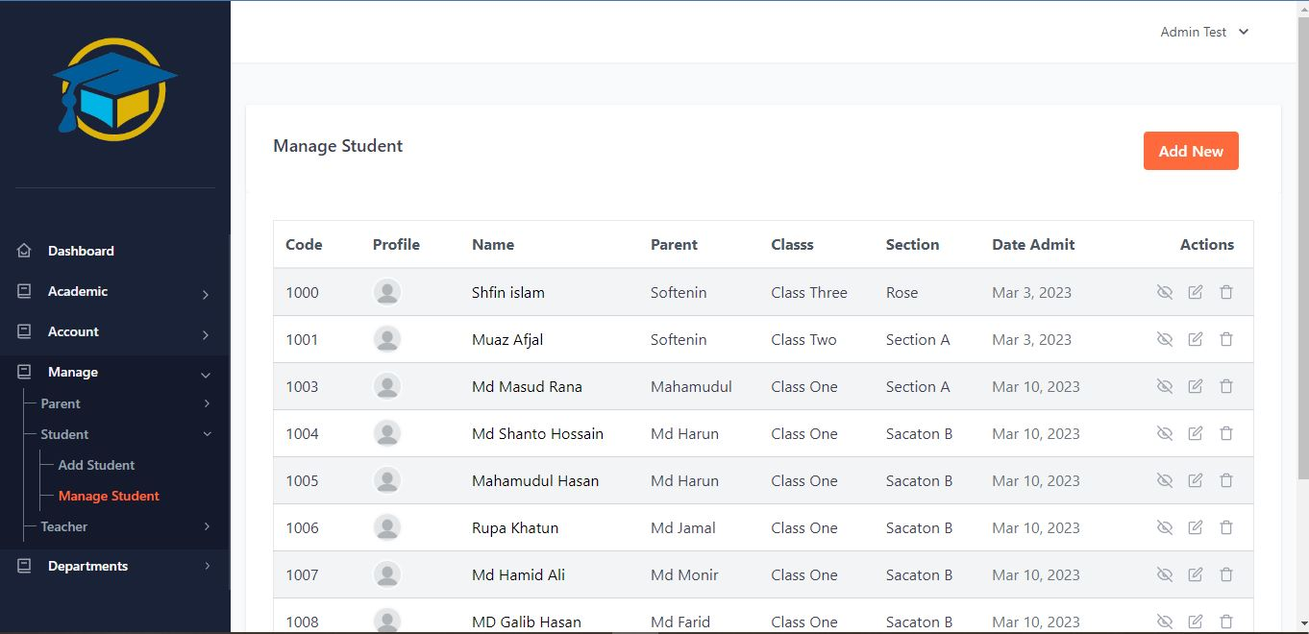
Implementation (Cont.)
23

Slide 24
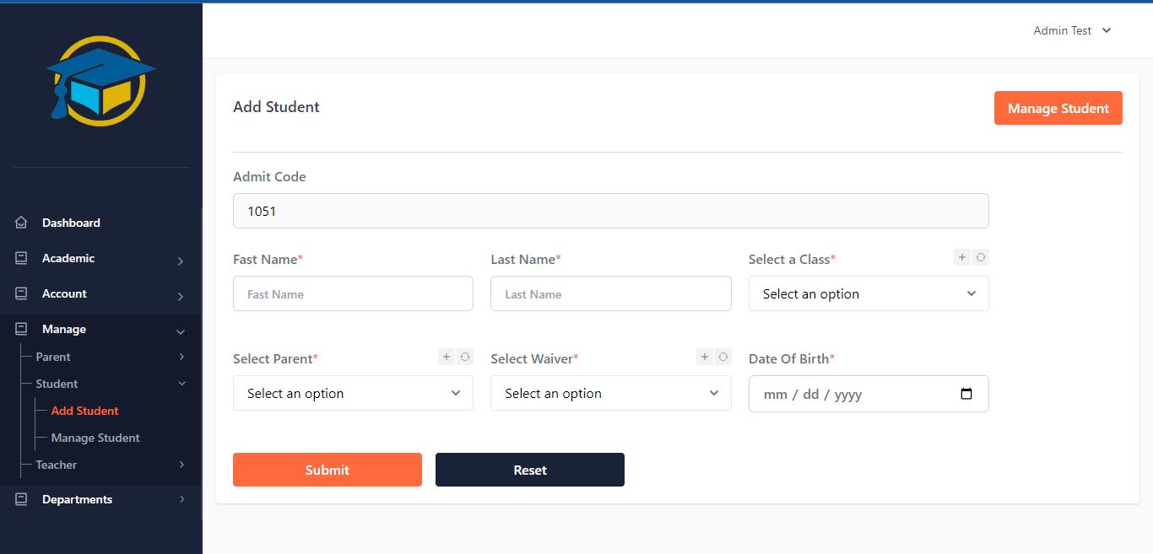
Implementation (Cont.)
24

Slide 25
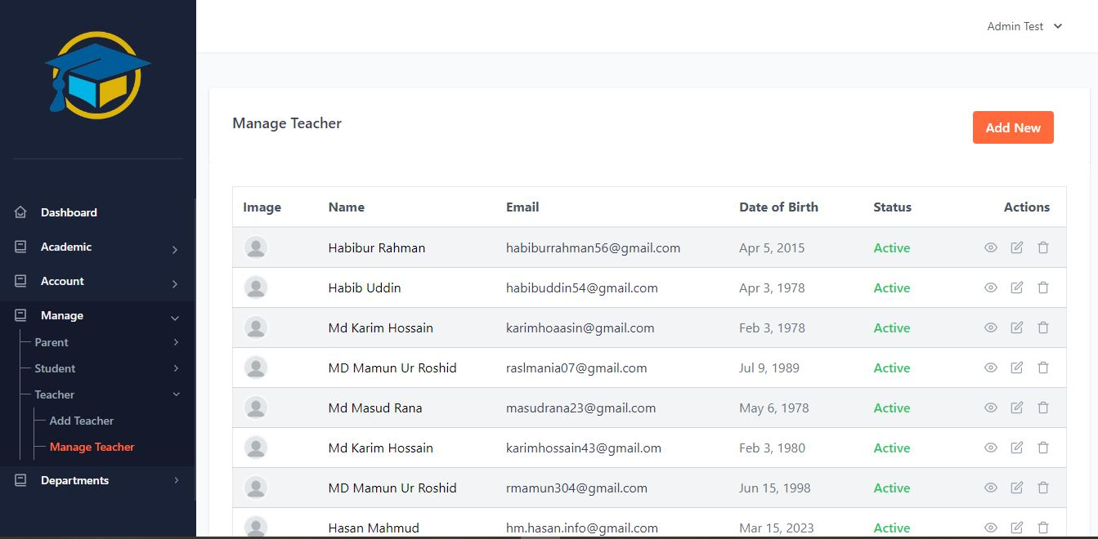
Implementation (Cont.)
25

Slide 26
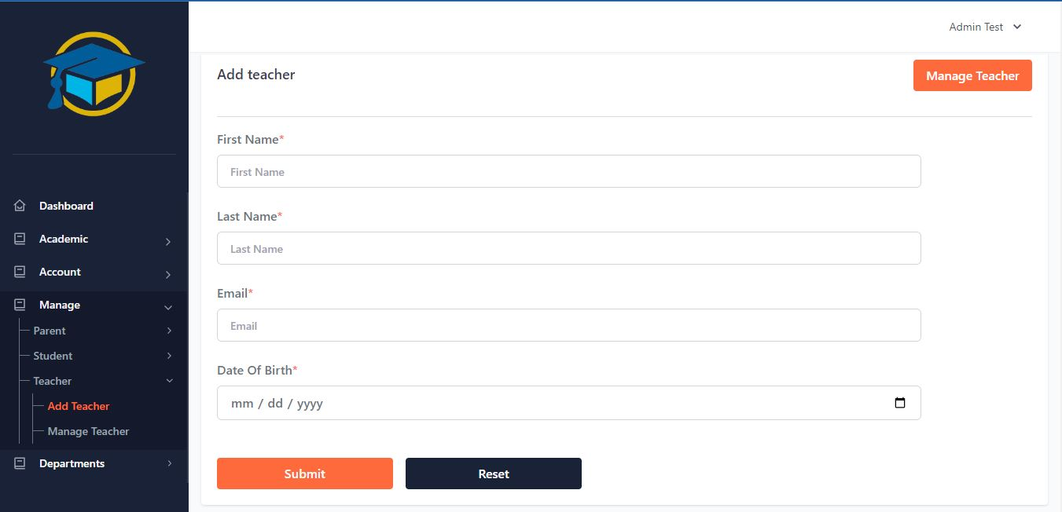
Implementation (Cont.)
26

Slide 27
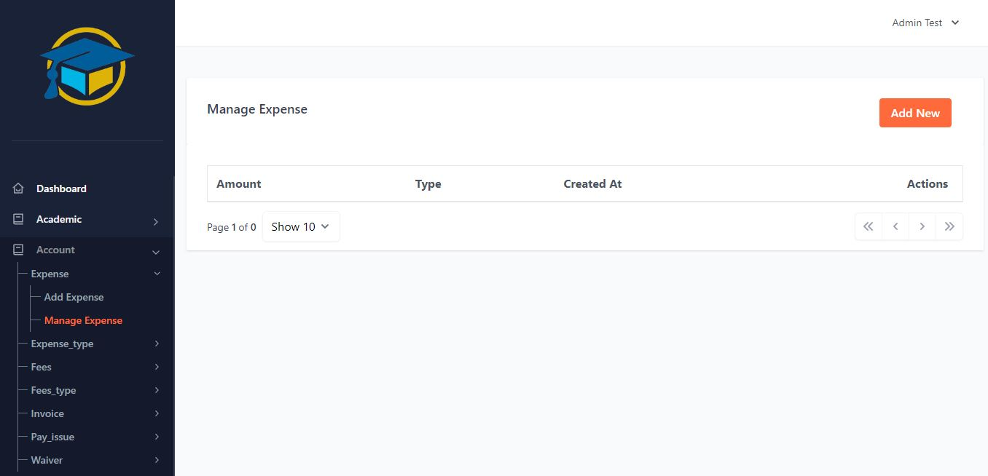
Implementation (Cont.)
27

Slide 28
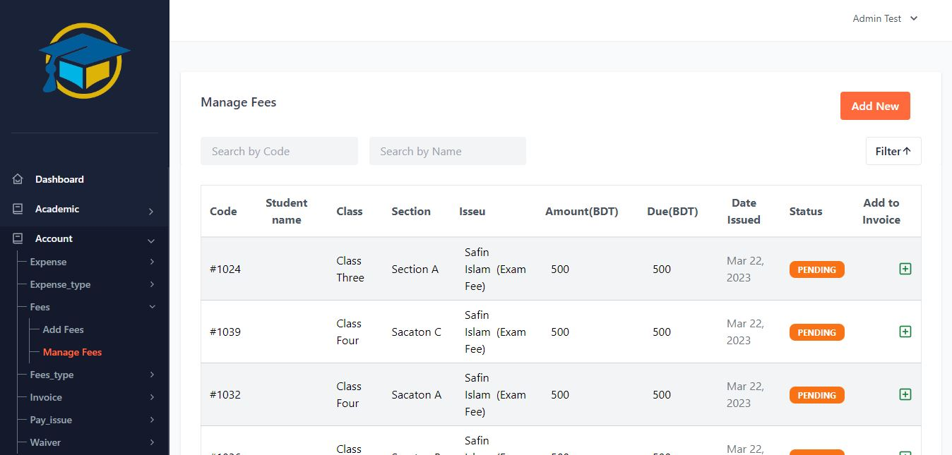
Implementation (Cont.)
28

Slide 29
Future Work
29
Question bank per subject.
Let the student take the exam online.
Let the teacher add questions to the question bank.
Allow admin to add new classes.
Add a medical examination section to the system with a medical supervisor as a new one the user.

Slide 30
Conclusion
30
Primary Student management systems can be used by educational institutions to easily maintain their student records.
Achieving this objective using manual systems is difficult because information is scattered, may be redundant, and collecting relevant information can be very time consuming.
This arrangement helps the students of the institution to maintain information. It can be easily accessed by the manager and kept safe for a long time without any changes.

Slide 31
31
References
[1] www.bidyaan.com
[2] www.extreme.com.bd
[3] www.myclasscampus.com

Slide 32

32

